Slide 1
Multi Tables - Query
Arif Muntasa

Slide 2
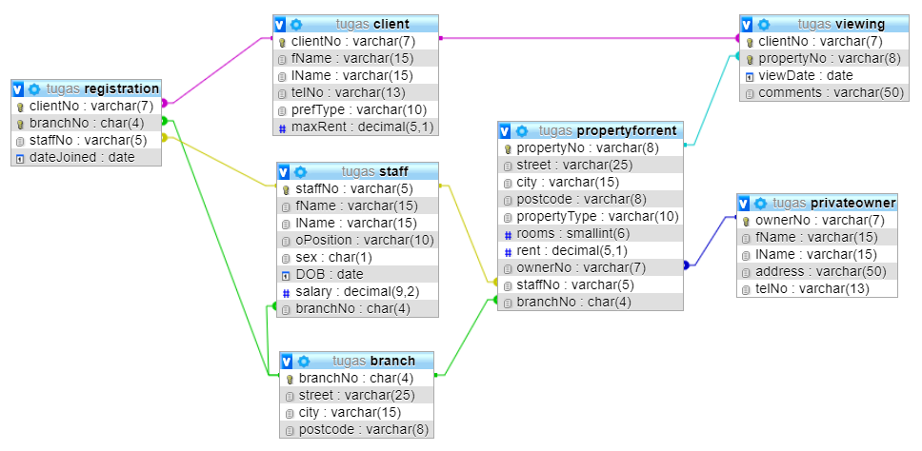
The Dream Home Model

Slide 3
Perhatikan
Tabel “Registrasi”, TIDAK DAPAT menampilkan
Data Client (nama awal, nama akhir, . . . .)
Data Branch (jalan, kota, kode Pos)
Data Staff (nama awal, nama akhir, posisi, tanggal lahir, . . . . .)
Namun BERELASI dengan Tabel Client, Branch, dan Staff

Slide 4
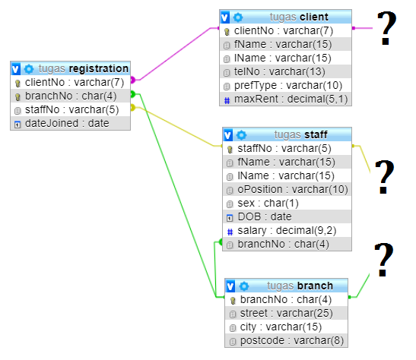
Relasi tabel REGISTRASI dengan CLIENT, STAFF, dan BRANCH

Slide 5
Model Relasi
Select T1.a11, T1.a21, T2.a21, T2.a22, . . .
from T1, T2
where T1.a11=T2.a21
T1.a11 adalah primary key
T2.a21 adalah foreign key yang mengacu pada tabel T1 dengan attribut a11 (T1.a11)

Slide 6
Memanfaatkan Relasi Antar Tabel

Slide 7
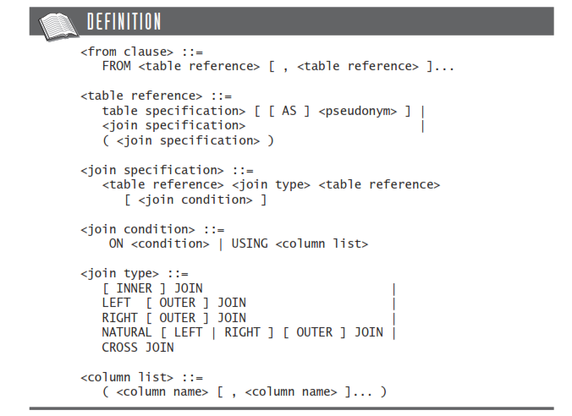
Join

Slide 8
Sub Query
Query yang diletakkan dalam Query
Bisa diletakkan di clausa SELECT ataupun di clausa WHERE

Slide 9
Tampilkan jumlah pegawai dan gaji tiap tiap cabang
Cara 1
SELECT branchNo, COUNT(staffNo) AS "count", SUM(salary) AS "sum"
FROM Staff
GROUP BY branchNo
ORDER BY SUM(salary);

Slide 10
Cara 2
Tahap 1 (Yang dihasilkan 1 record jumlah total pegawai)
SELECT COUNT(staff.staffNo)
FROM staff, branch
WHERE branch.branchNo=staff.branchNo

Slide 11
Cara 2
Tahap 2 (Yang dihasilkan 1 record Gaji total pegawai
SELECT SUM(staff.salary)
FROM staff, branch
WHERE branch.branchNo=staff.branchNo

Slide 12
Cara 2
Tahap 3
SELECT branch.branchNo,
(
SELECT COUNT(staff.staffNo)
FROM staff . BRANCH
WHERE branch.branchNo=staff.branchNo),
(
SELECT SUM(staff.salary)
FROM staff . BRANCH
WHERE branch.branchNo=staff.branchNo
)
FROM BRANCH
WHERE (SELECT COUNT(staff.staffNo) FROM staff WHERE branch.branchNo=staff.branchNo) >0
ORDER BY branch.branchNo

Slide 13
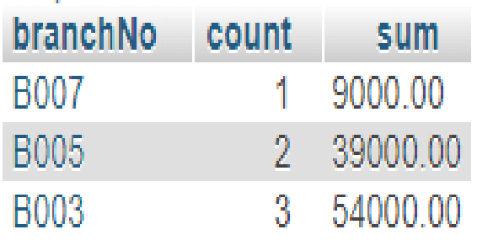
Hasil Query

Slide 14
Tampilkan staff yang bekerja di alamat "163 Main St"
Cara 1
SELECT staffNo, fName, lName, oPosition
FROM Staff, branch
WHERE Staff.branchNo=branch.branchNo and branch.street LIKE '163 Main St%';

Slide 15
Cara lain menggunakan Subquery
Cara 2
SELECT staffNo, fName, lName, oPosition
FROM Staff
WHERE branchNo =
(SELECT branchNo
FROM Branch
WHERE street LIKE '163 Main St%') ;

Slide 16
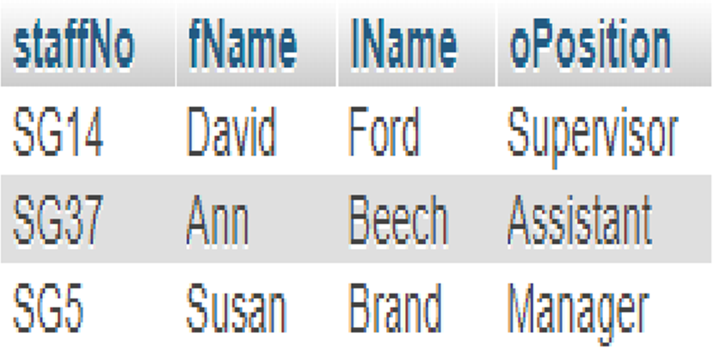
Hasil Query

Slide 17
Tampilkan staff yang gajinya lebih besar dari gaji rata-rata
Tahap 1, cari rata-rata gaji pegawai
SELECT avg(salary)
FROM staff

Slide 18
Perhatikan attribut keempat dan expresi di clausa where (Huruf warna merah)
Tahap 2
SELECT staffNo, fName, lName, oPosition,
(salary - (SELECT AVG(salary) FROM Staff)) AS salDiff
FROM Staff
WHERE salary > (SELECT AVG(salary) FROM Staff) ;

Slide 19
Tampilkan daftar property yang dihandel staf yang bekerja di cabang ‘163 Main St’.
cara 1
SELECT p.propertyNo, p.street, p.city, p.postcode, p.propertyType,
p.rooms, p.rent
FROM PropertyForRent p, staff s, branch b
WHERE p.staffNo=s.staffNo and s.branchNo=b.branchNo and
b.street = '163 Main St';

Slide 20
Cara Lain Menggunakan Subquery
Cara 2
SELECT propertyNo, street, city, postcode, propertyType, rooms, rent
FROM PropertyForRent
WHERE staffNo IN (SELECT staffNo
FROM Staff
WHERE branchNo = (SELECT branchNo
FROM Branch
WHERE street = '163 Main St'));

Slide 21
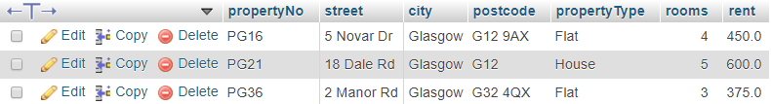
Hasil Query

Slide 22
Berapa Jumlah property yang dihandel staf yang bekerja di cabang ‘163 Main St’.
Cara 1
SELECT count(*) as Jumlah
FROM PropertyForRent p, staff s, branch b
WHERE p.staffNo=s.staffNo and
s.branchNo=b.branchNo and
b.street = '163 Main St';

Slide 23
Cara Lain Menggunakan Subquery
Cara 2
SELECT count(*)
FROM PropertyForRent
WHERE staffNo IN (SELECT staffNo
FROM Staff
WHERE branchNo = (SELECT branchNo
FROM Branch
WHERE street = '163 Main St'));

Slide 24
Dapatkan semua staf yang gajinya lebih besar dari gaji setidakanya satu staff yang ada di B003
Tahap 1
SELECT staffNo, fName, lName, oPosition, Salary
FROM Staff
Tahap 2
SELECT salary
FROM Staff
WHERE branchNo = 'B003'

Slide 25
Menggabungkan Kedua Tahap
Tahap 3
SELECT staffNo, fName, lName, oPosition, Salary
FROM Staff
WHERE salary > SOME(SELECT salary
FROM Staff
WHERE branchNo = 'B003');

Slide 26
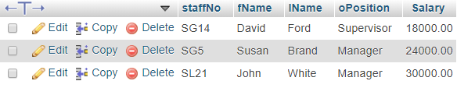
Hasil Query

Slide 27
Dapatkan semua staf yang gajinya lebih besar dari gaji staff yang ada di B003
Tahap 1
SELECT staffNo, fName, lName, oPosition, Salary
FROM Staff
Tahap 2
SELECT salary
FROM Staff
WHERE branchNo = 'B003'

Slide 28
Penggabungan 2 tahap
Tahap 3
SELECT staffNo, fName, lName, oPosition, Salary
FROM Staff
WHERE salary > ALL(SELECT salary
FROM Staff
WHERE branchNo = 'B003');

Slide 29
Hasil Query

Slide 30
Tampilkan semua nama client yang telah melihat property beserta komentar apa pun yang diberikan
Cara 1
SELECT C.clientNo, fName, lName, propertyNo, comments
FROM Client C, Viewing V
WHERE C.clientNo = V.clientNo ;

Slide 31
Cara 2
SELECT C.clientNo, fName, lName, propertyNo, comments
FROM Client C JOIN Viewing V
ON C.clientNo = V.clientNo;

Slide 32
Cara 3
SELECT clientNo, fName, lName, propertyNo, comments
FROM Client JOIN Viewing USING (clientNo);

Slide 33
Cara 4
SELECT clientNo, fName, lName, propertyNo, comments
FROM Client NATURAL JOIN Viewing

Slide 34
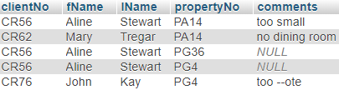
Hasil Query

Slide 35
Tampilkan Jumlah property yang ditangani oleh anggota staff
SELECT S.branchNo, S.staffNo, COUNT(*) AS "count"
FROM Staff S, PropertyForRent P
WHERE S.staffNo = P.staffNo
GROUP BY S.branchNo, S.staffNo
ORDER BY S.branchNo, S.staffNo ;

Slide 36

Hasil Query

Slide 37
Tampilkan semua staff yang bekerja di london
Cara 1
SELECT S.staffNo, S.fName, S.lName, S.oPosition
FROM Staff S, branch B
WHERE S.branchNo=B.branchNo and B.city= 'London';

Slide 38
Cara 2
SELECT staffNo, fName, lName, oPosition
FROM Staff S
WHERE EXISTS (SELECT *
FROM Branch B
WHERE S.branchNo = B.branchNo AND city = 'London');

Slide 39

Hasil Query

